Slide 1
Lecture # 16
Equivalent Machines
Moore to Mealy Machine
Mealy to Moore Machine

Slide 2
Equivalent Machines
Two machines are said to be equivalent if they print the same output string when the same input string is run on them.
Remark
Two Moore machines may be equivalent. Similarly two Mealy machines may also be equivalent, but a Moore machine can’t be equivalent to any Mealy machine. However, ignoring the extra character printed by the Moore machine, there exists a Mealy machine which is equivalent to the Moore machine.

Slide 3
Theorem
For every Moore machine there is a Mealy machine that is equivalent to it (ignoring the extra character printed by the Moore machine).
Proof
Let M be a Moore machine, then shifting the output characters corresponding to each state to the labels of corresponding incoming transitions, machine thus obtained will be a Mealy machine equivalent to M.

Slide 4
Note
It may be noted that while converting a Moore machine into an equivalent Mealy machine, the output character of a state will be ignored if there is no incoming transition at that state.
A loop at a state is also supposed to be an incoming transition.

Slide 5
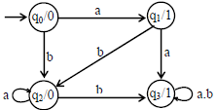
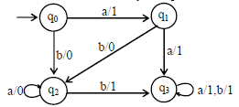
Example
Consider the following Moore machine
Using the method described earlier, the above machine may be equivalent to the following Mealy machine.

Slide 6
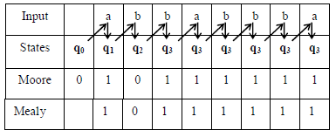
Running the string abbabbba on both the machines, the output string can be determined by the following table

Slide 7
Theorem
For every Mealy machine there is a Moore machine that is equivalent to it (ignoring the extra character printed the Moore machine).
Proof
Let M be a Mealy machine. At each state there are two possibilities for incoming transitions
The incoming transitions have the same output character.
The incoming transitions have different output characters.
If all the transitions have same output characters, then shift that character to the corresponding state.

Slide 8
Proof contd…
If all the transitions have different output characters, then the state will be converted to as many states as the number of different output characters for these transitions, which shows that if this happens at state qi then qi will be converted to qi¹ and qi²
i.e. if at qi there are the transitions with two output characters then qi¹ for one character and qi² for other character.
Shift the output characters of the transitions to the corresponding new states qi¹ and qi².
Moreover, these new states qi¹ and qi² should behave like qi as well.
Continuing the process, the machine thus obtained, will be a Moore machine equivalent to Mealy machine M.

Slide 9
Note
It may be noted that if there is no incoming transition at certain state then any of the output characters may be associated with that state.
It may also be noted that if the initial state is converted into more than one new states then only one of these new states will be considered to be the initial state.

Slide 10
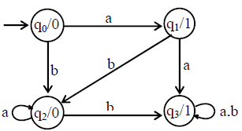
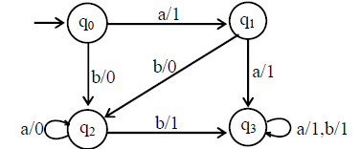
Example
Consider the following machine
Using the method described earlier, the above machine may be equivalent to the following Mealy machine

Slide 11
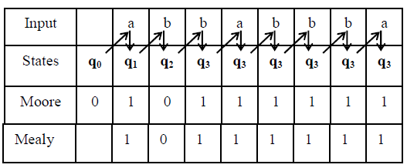
Running the string abbabbba on both the machines, the output string can be determined by the following table

Slide 12
Theorem
Statement
For every Mealy machine there is a Moore machine that is equivalent to it (ignoring the extra character printed the Moore machine).
Proof
Let M be a Mealy machine. At each state there are two possibilities for incoming transitions. The incoming transitions have the same output character. The incoming transitions have different output characters. If all the transitions have same output characters, then shift that character to the corresponding state.

Slide 13
Proof contniues…
If all the transitions have different output characters, then the state will be converted to as many states as the number of different output characters for these transitions, which shows that if this happens at state qi then qi will be converted to qi¹ and qi² i.e. if at qi there are the transitions with two output characters then qi1 for one character and qi² for other character. Shift the output characters of the transitions to the corresponding new states qi¹ and qi². Moreover, these new states qi¹ and qi² should behave like qi as well. Continuing the process, the machine thus obtained, will be a Moore machine equivalent to Mealy machine M.

Slide 14
Note
It may be noted that if there is no incoming transition at certain state then any of the output characters may be associated with that state.
It may also be noted that if the initial state is converted into more than one new states then only one of these new states will be considered to be the initial state.

Slide 15
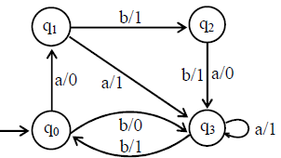
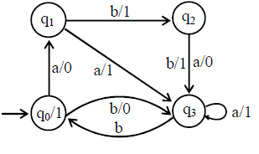
Example
Consider the following Mealy machine.
Shifting the output character 1 of transition b to q₀

Slide 16
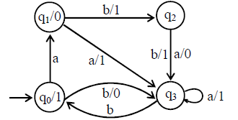
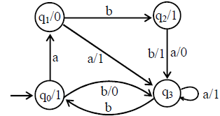
Shifting the output character 0 of transition a to q₁
Shifting the output character 1 of transition b to q₂

Slide 17
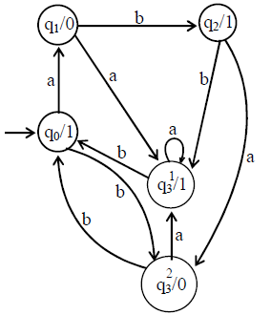
Splitting q₃ into q¹₃ and q²₃

Slide 18
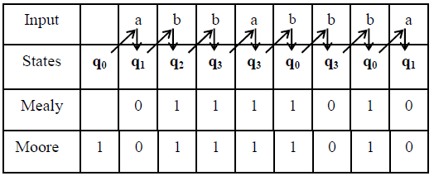
Running the string abbabbba on both the machines, the output strings can be determined by the following table

